Slide 1

CMN 1160A – Introduction to Media Studies
Week 3A: Communication: Social and Cultural Forms
Daniel J. Paré
University of Ottawa, Department of Communication
September 20, 2016
Notes:
1

Slide 2
Preview
Harold Innis
Marshall McLuhan
Technological Determinism
Notes:
2

Slide 3
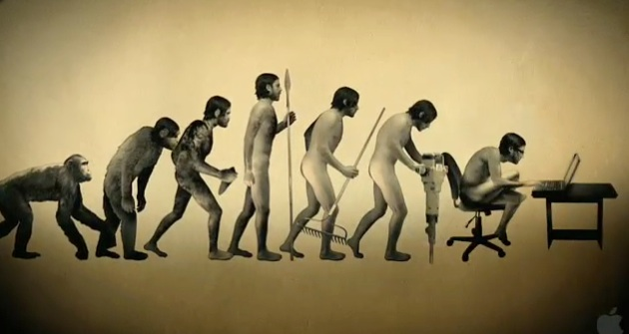
Some Characteristics of Media
Oral communication
Literate communication
Electronic communication

Slide 4
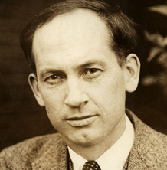
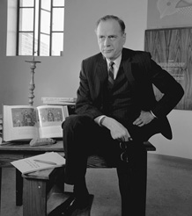
Media and Social Form
Harold Innis (1894-1952)
Marshall McLuhan (1911-1980)
Economic model of communication
Psychological model
of communication
Find further info at: http://www.collectionscanada.gc.ca/innis-mcluhan/index-e.html

Slide 5
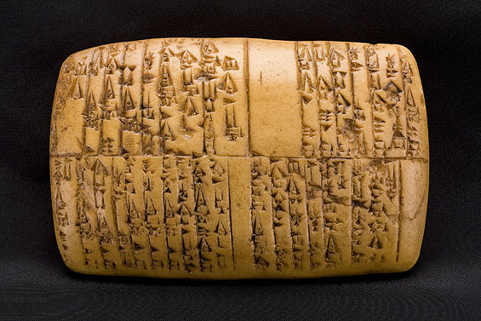
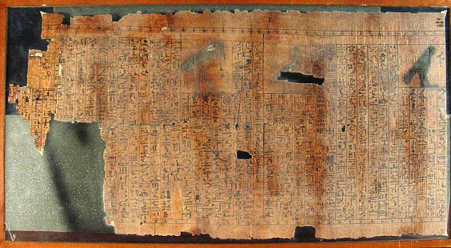

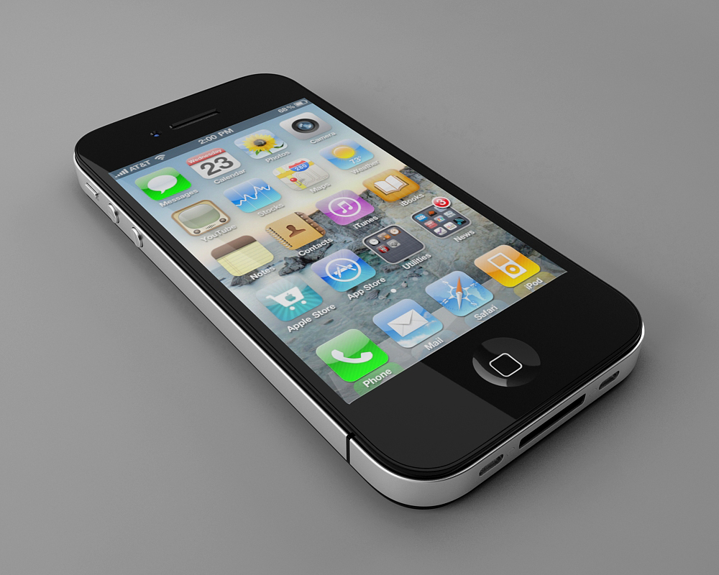
Innis - 3 Basic Questions
1. How do specific communication technologies operate?
2. What assumptions do they take from and contribute to society?
3. What forms of power do they encourage?

Slide 6
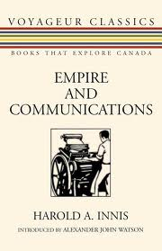
Innis & Empire
Studies of the Civilizations of:
Ancient Egypt;
Babylonia;
Mesopotamia;
As well as effects of
Oral tradition on Greek civilization; and
Written tradition on Roman Empire

Slide 7
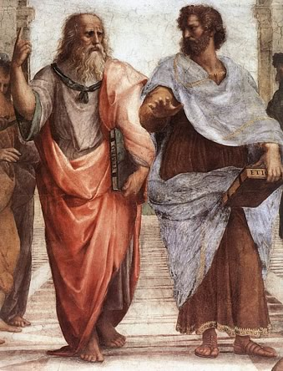
From Oral to Literate Society

Slide 8
Time Bias vs. Space Bias
Durable media difficult to transport
tradition bound;
emphasis on customs - rituals - moral values;
hierarchical social order;
ruled by elite;
monopoly of knowledge;
challenged by lighter media
Media easy to transport;
oriented to expansion and accumulation;
secular institutions;
complex forms of political authority;
creates abstract forms of knowledge;
challenged by inability to expand and need for ritual

Slide 9
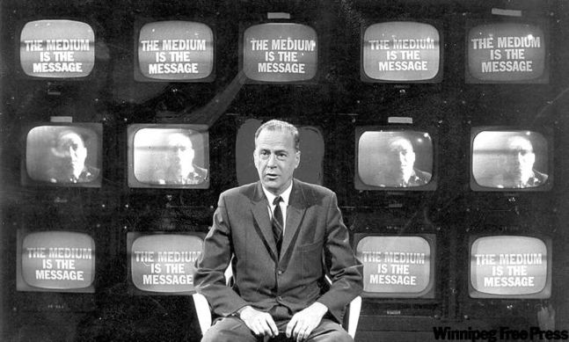
From Literate to Electronic Society

Slide 10

McLuhan’s view of history
Pre-Literate Man (Pre- 1450s):
Oral culture
Tribal
Active, participatory, social
Balanced senses
Community
Connectivity

Slide 11
McLuhan’s view of history
Literate Man (1450s - 1900):
Books = The dominant medium
Individualism
The eye
Detached
De-tribalization

Slide 12
McLuhan’s view of history
Post-Literate Man (1900 onward):
Books no longer dominant medium
Electric media (e.g. Television) is dominant
Senses in balance again
Simultaneous involvement
Re-tribalization of man
Global Village

Slide 13
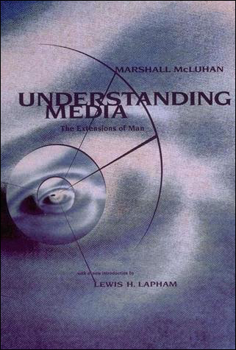
“The medium is the message”
Content of media not as important as the effect that the medium has on human minds and culture
Social change brought about by the medium IS the message
Content is NEVER the message because content always is the ‘old’ medium

Slide 14
“The medium is the Message”
Can we really be so deterministic in our world view?
Hmmm, think of the printing press

Slide 15
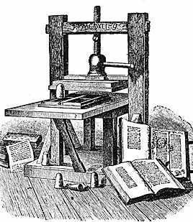
“The medium is the Message”
Gutenberg Printing Press, 1440:
Literacy
Standardization of regional dialects
National languages replace Latin
Individualism
Age of Reason / Renaissance
Destruction of feudal power structures

Slide 16

A Global Village?
McLuhan:
Print media alienates humans from their ‘natural state’ – detribalization
TV = retribalization = Global village
Putnam:
May be retribalized, BUT ‘village’ has no social capital

